Slide 1
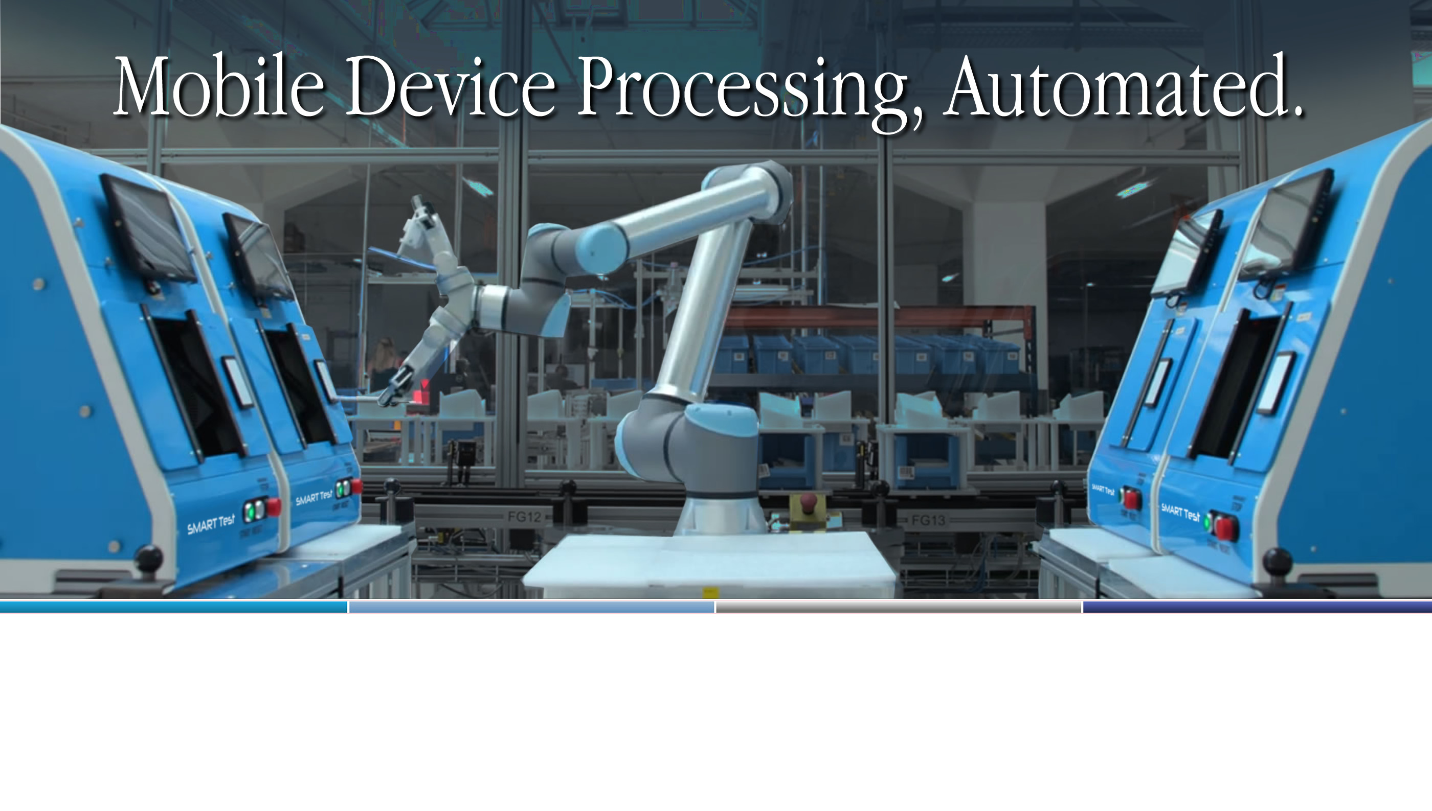

Mobile Device Processing Automation & Business Intelligence Solutions

Slide 2


FutureDial is the leader in software, robotics and data-driven business intelligence for the mobile device
supply chain.
We automate device processing, improve workflows and help you optimize your operations with data-driven business intelligence.

Slide 3
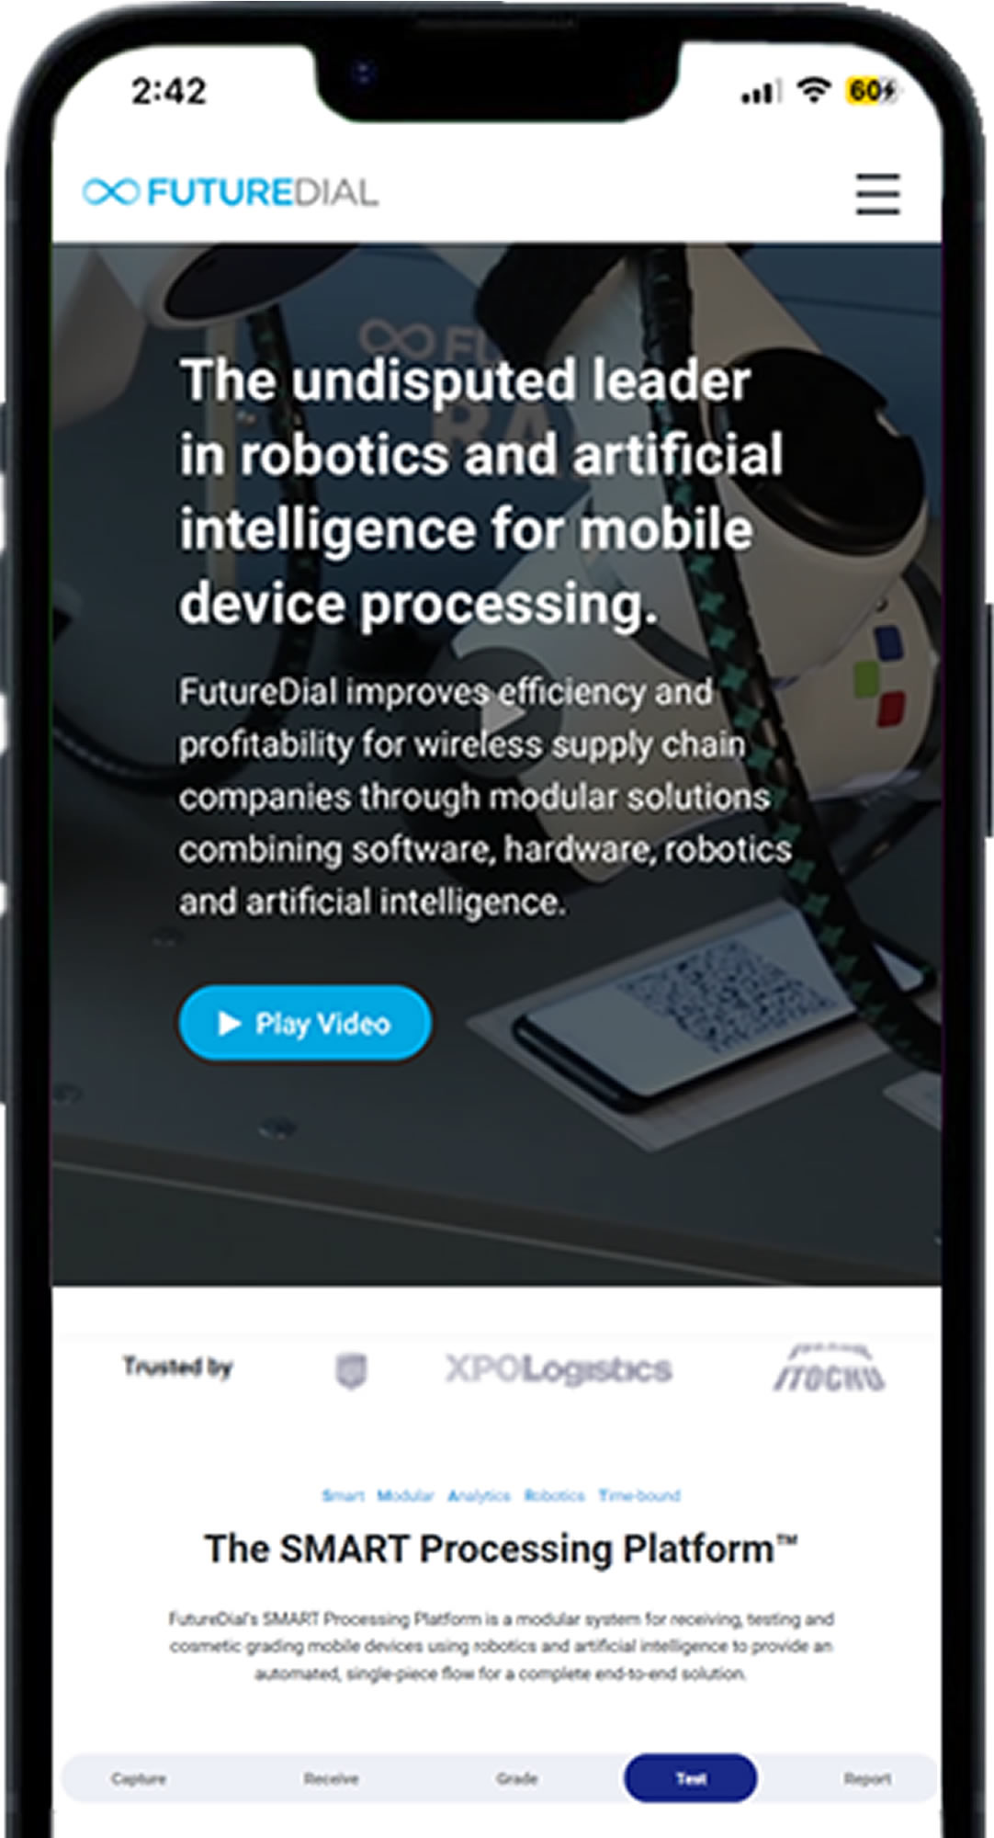




Company Overview
Founded in 1999, with Headquarters
in Sunnyvale, CA.
Global Presence in the U.S.A., the U.K. and Europe, and Asia.
310+ Million Mobile Devices Processed.
100+ Employees Worldwide.

Slide 4

Unique Value
World class software expertise and experience in the core functions of mobile device refurbishment.
2. Industry leadership in developing, integrating, and
strategically deploying automation software and
robotics for mobile device refurbishment processes.
3. Deploying information management solutions to
drive increased efficiency, better decisions and
improved profits.

Slide 5









Why FutureDial
25 Year Company
Long History of Profitability and Cash Positive Performance.
Industry Leader
Serving the Mobile Device
Reverse Logistics Industry.
350+ Mil. Processed
The Most Solutions Deployed in the Industry Worldwide.
Minimal Cost to Change
Compelling Net ROI Calculations for Customers
Most Experienced Path
Automation with Proven Tech
Global Scalability
Dedicated, Dependable Support

Slide 6



Our Team Locations
EMEA,
London, UK
Sales
Account Management
ASIA,
Nanjing, China,
Engineering
R&D
ASIA,
Tokyo, Japan
Sales
Account Management
Onsite support
USA HQ
Silicon Valley, CA
Engineering
Sales
Account Management
ASIA,
Taipei, Taiwan
Sales
Engineering
Account Management

Slide 7

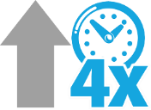

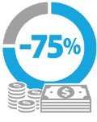
Gains from the SMART Processing Platform™
Quadruple Increase
in UPH
(Units Per Hour)
76% Less Labor Required
Reduction in
Cost Per Unit
Greater Accuracy in
Processing Tasks

Slide 8
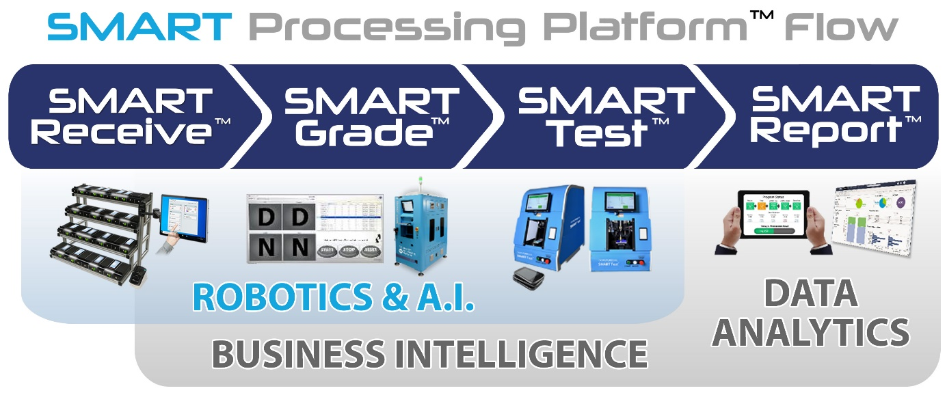
SMART Processing Platform™ Benefits
The SMART Processing Platform™ offers benefits through workflow improvements
and intelligent technology applied at
mission-critical touchpoints in an operation:
33% Accuracy increase using robotic testing
15% Revenue gain with AI grading solution
10%+ Higher offer for Buyback / Retention
85% Reduction in NTF units to OEMs
75% Labor reduction with automation
400% Increase in UPH
10%+ Reusable Stock – CPO, Warranty & Insurance

Slide 9
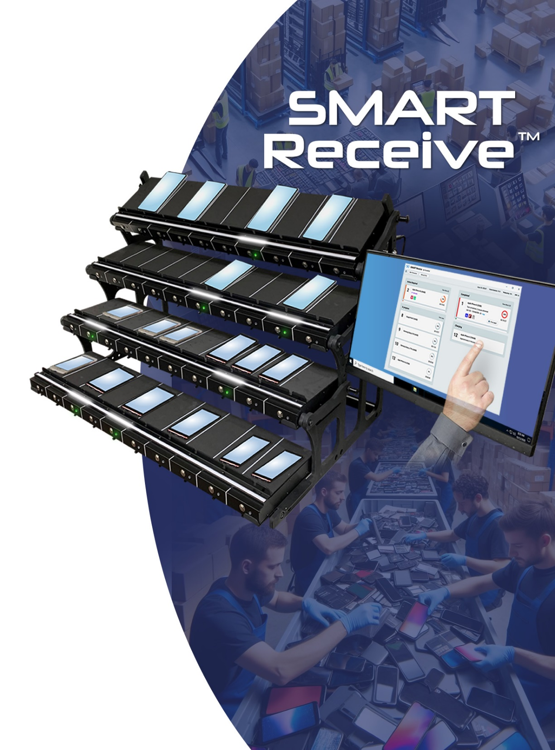
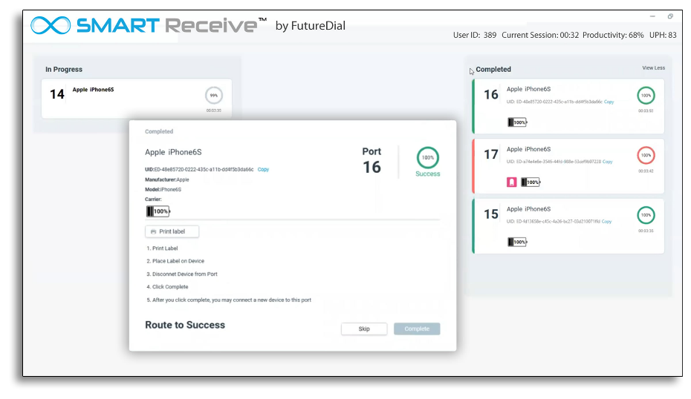
SMART Receive™
Streamlines the device receiving process at warehouses and processing centers, removing bottlenecks.
Solution Type: Software & Hardware
Features:
Identifies devices/Adds to Inventory
Retrieves Device Disposition
Retrieves 3rd Party SMART Tests & Grades
Data Clears Devices (Dynamically)
Charges Device Batteries
Loads Apps for Testing & Grading
Benefits/Advantages:
Minimal Worker Interaction
Device-Adaptive (single-piece flow)
API Interaction with Client Systems

Slide 10
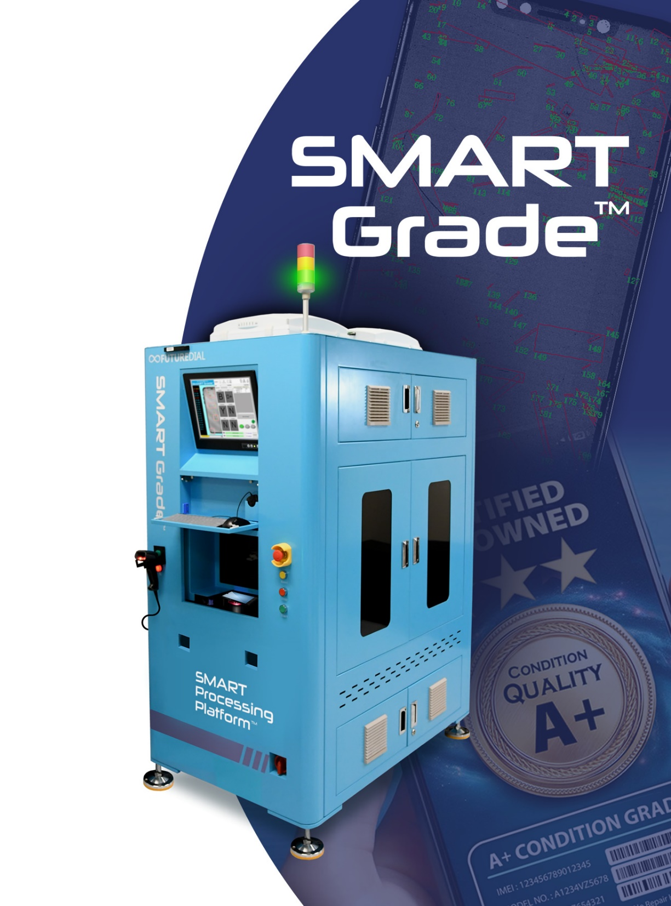
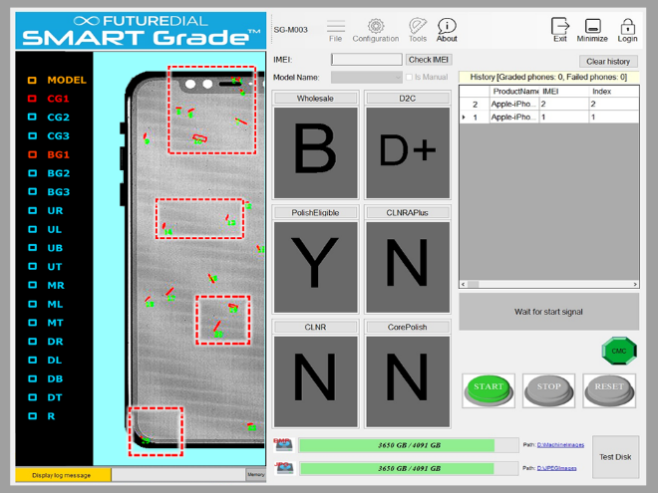
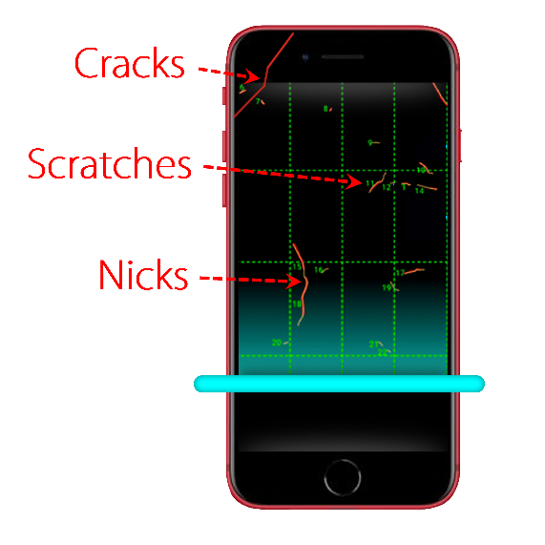
SMART Grade™
Robotic Scanning & Grading of Device Surface Condition
Solution Type: Hardware & Software
Features:
Auto device detection
Screen Visual Test
Full Surface Inspection & Grading (6 sides)
Customizable Grading Criteria
Results Available in CMC Analytics
Benefits/Advantages:
~60-120 Mobile Devices Scanned per Hour per Robot
Rapid Processing - Under 1 min per Device.
1 SMART Grade works with up to 6 SMART Test Robots
Storage of Scan/Grading Results: Local or Cloud

Slide 11
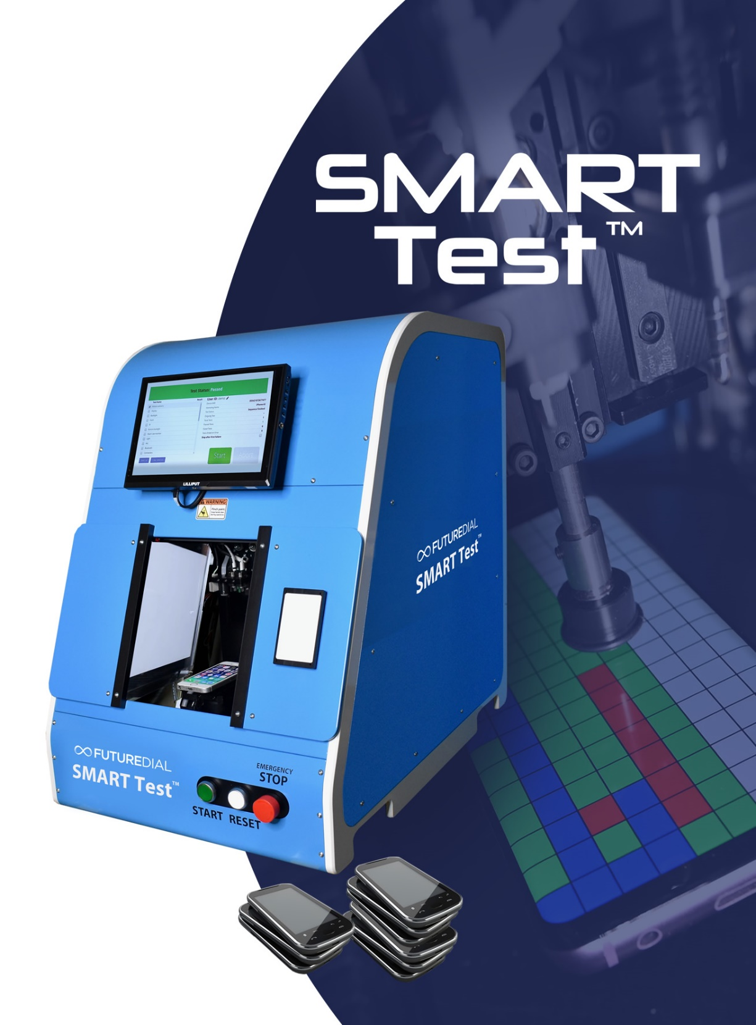
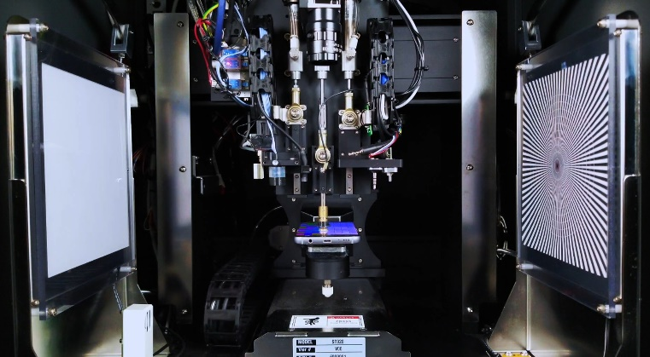
SMART Test™
Accurate Robotic Functional Testing of Mobile Devices.
Solution Type: Hardware & Software
Features:
Device Agnostic (No pre-sorting)
No Loading Tray(s) or Jigs Needed
Data Clear (2nd)
Customizable & Flexible Test Sequencing
Results Available in SMART Report Data Analytics
Devices can be Hand-fed or use Robotic Arm Loading
Performance:
18-20 Units/hr per Robot
Scalable 6-8 Robots per Line
1 Operator per 6 SMART Test
1 Robotic Arm per 8 SMART Test
Run Time 180 Seconds (Full Test)
Run Time 60 Seconds (Soff)

Slide 12
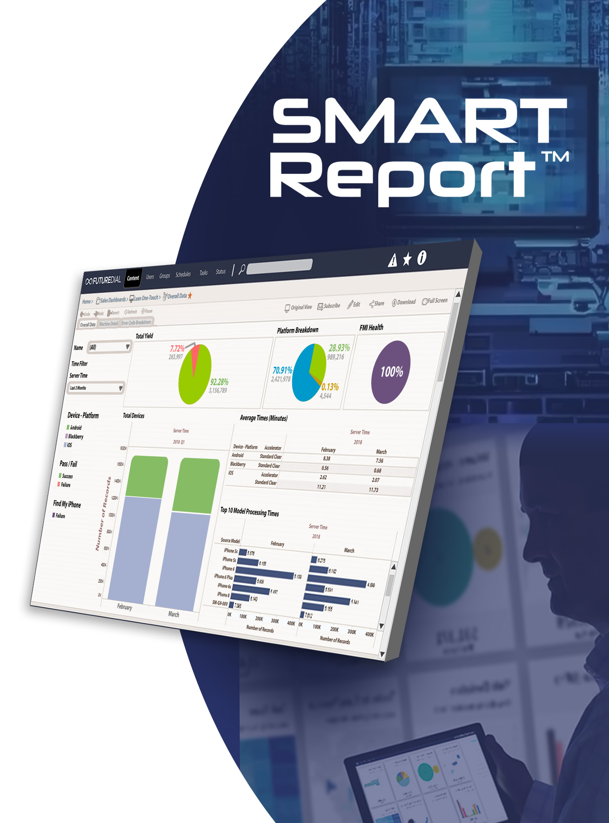
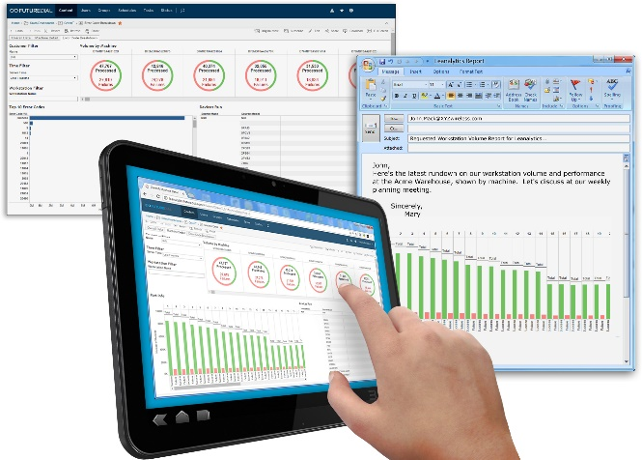
SMART Report™
Customizable Intelligent Data Analytics to Drive Mobile Supply Chain Operations
Solution Type: Cloud-based Software
Features:
Integrates with SMART Processing Platform™ solutions on the line
Enables Admin-level tracking and monitoring of operations
Intelligent Routing
Benefits/Advantages:
Drill down to monitor individual workstations on-site
Helps identify trends in line operations
Real-time data analytics
Pricing and Process Optimization

Slide 13
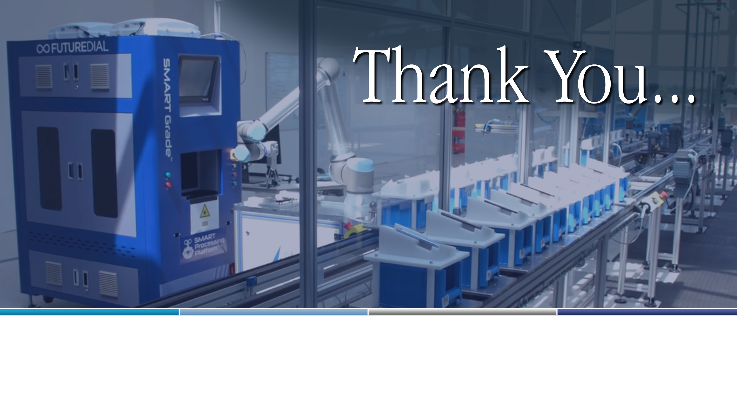
FutureDial, Incorporated
392 Potrero Ave., Sunnyvale, CA 94085
www.futuredial.com
( Proprietary & Confidential )

